Slide 1
Online Car Rental System
Venkata Naga Akash Ungarala

Slide 2
Reason to design this system:
Enhancing business process- Increasing ROI.
Online Vehicle Reservation- Prior to pick up date/time.
Customer’s Registration- Know them better and improving services.

Slide 3
Software Environment
Database - MySQL
Back-End Design - Java Servlet Programming
Front-End Design - JSP, HTML, CSS
IDE – NetBeans

Slide 4
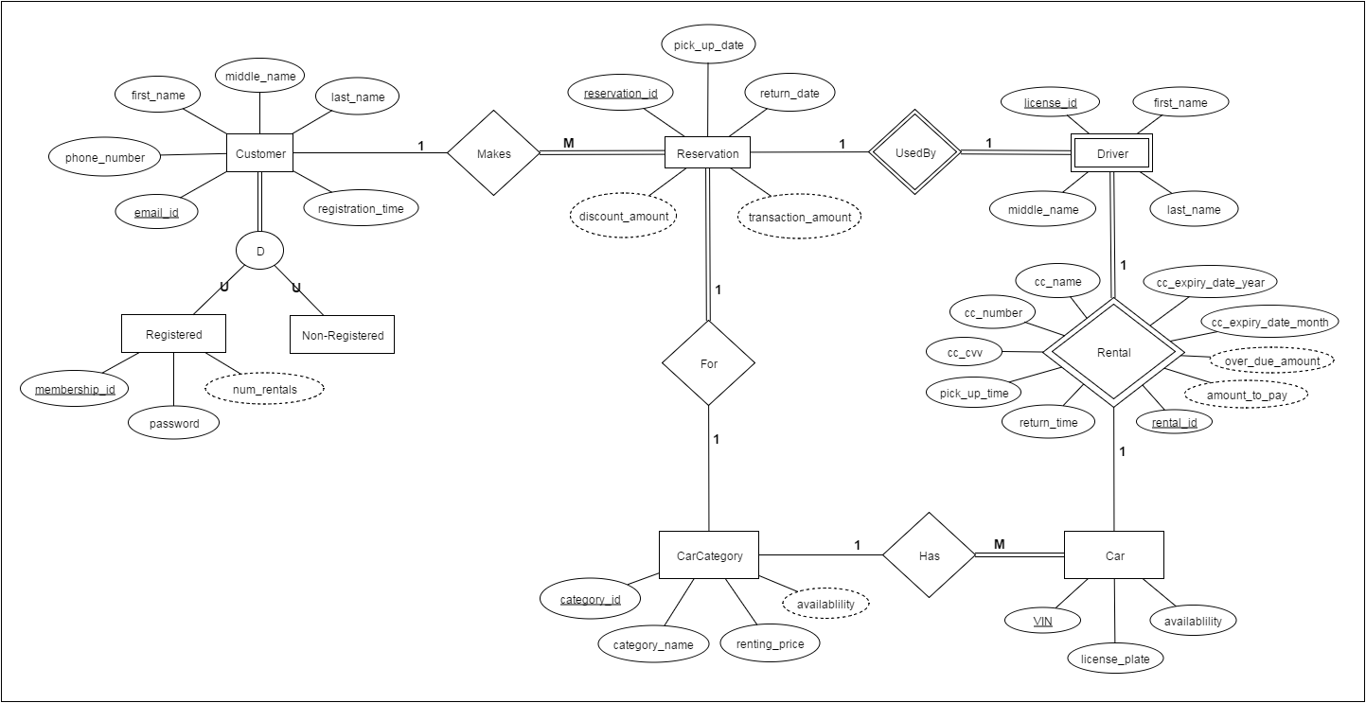
Entity Relationship Diagram

Slide 5
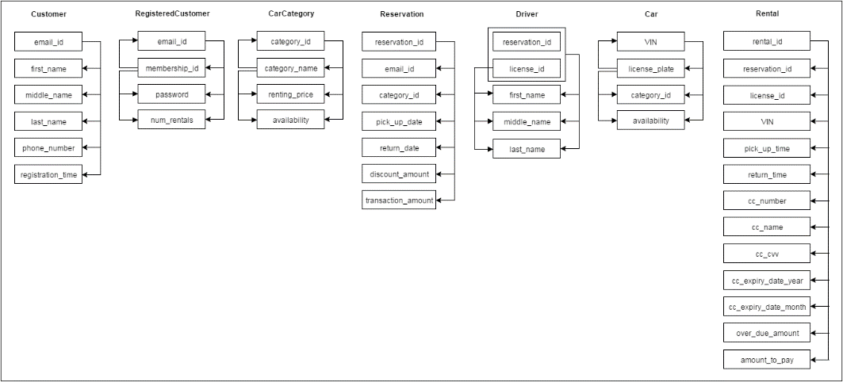
Functional Dependencies

Slide 6
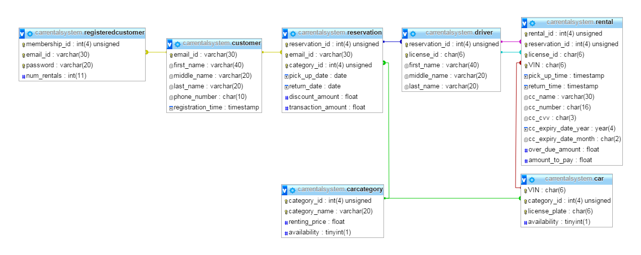
Table Definitions

Slide 7
Sample Data for Customer Table
Sl. No. | Email ID (first_name@gmail.com) | First Name | Middle Name | Last Name | Phone Number
1 | akash@gmail.com | Akash | Venkata Naga | Ungarala | 9803378946
2 | Imani@gmail.com | Imani |  | Bansal | 3152108765
3 | Aaradhna@gmail.com | Aaradhana |  | Raghunathan | 980765453
4 | Madhuvani@gmail.com | Madhuvani |  | Vanam | 987678654
5 | Alex@gmail.com | Alex |  | Phillips | 765654321
6 | Payton@gmail.com | Payton |  | Moore | 876543212
7 | Amanda@gmail.com | Amanda |  | Beth | 987765543
8 | Josh@gmail.com | Josh |  | Philips | 787654456
9 | Nicole@gmail.com | Nicole |  | Betts | 987765567
10 | Jennifer@gmail.com | Jennifer |  | Simmons | 878987654

Slide 8
Sample Data for Car Table
Sl. No. | Car Category (Sl. No.) | VIN | License Plate
1 | 1 | 2KJPDDJH51K971089 | LCH-3210
2 | 1 | 2BNPDDJH51K97100 | ABD-768
3 | 1 | 2WKPDDJH51K970989 | BGD-4321
4 | 1 | KMHHU6KJ1DU186741 | CVF-7865
5 | 1 | 5GAET13M262340847 | NJH-8765
6 | 1 | 2HGES16535HG81755 | SDF-8765
7 | 1 | 1HD1KAV106Y69592 | GHB-7865
8 | 1 | 5GAET13M262340848 | DVG-7653
9 | 2 | 1HD1KAV106Y695921 | BHG-5678
10 | 2 | 3FRWW6FC3DV072954 | BJR-8765
11 | 2 | JS1GL52A4D2145863 | KKF-7654
12 | 2 | 2WKPDDJH51K970990 | CJG-5678
13 | 2 | KMHHU6KJ1DU186742 | LKJ-9879

Slide 9
Sample Data for Car Category Table
Category_id | Category Name | Renting Price per day
1 | Economy | 25
2 | Intermediate | 24
3 | SUV | 28
4 | Luxury | 35
5 | Compact | 23
6 | Family | 26
7 | Convertible | 28
8 | Cargo Van | 34
9 | Mid-Level | 24
10 | Roadster | 34

Slide 10
Sample Data for Driver Table
Sl. No. | License ID | First Name | Middle Name | Last Name
1 | 887543214578 | Aiko | Roth | Carney
2 | 987656765432 | Charlotte |  | Phillips
3 | 787654321345 | Alex |  | Mathew
4 | 875534565432 | Adrian |  | Istrani
5 | 765432456765 | Matt |  | Phillips
6 | 343234567898 | Becca |  | Paradis
7 | 908767854321 | Joe | Anne

Slide 11
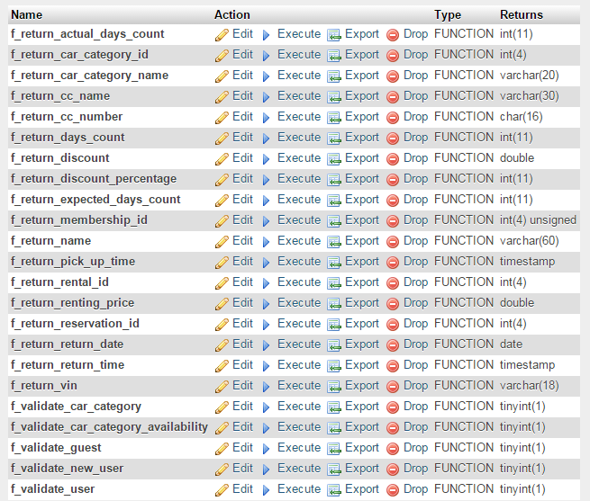
Functions

Slide 12
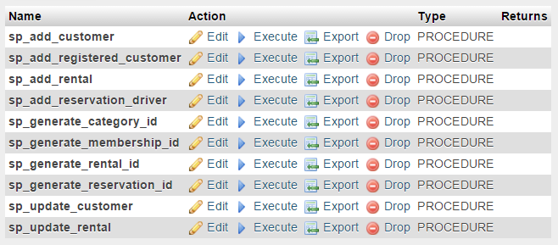
Procedures

Slide 13
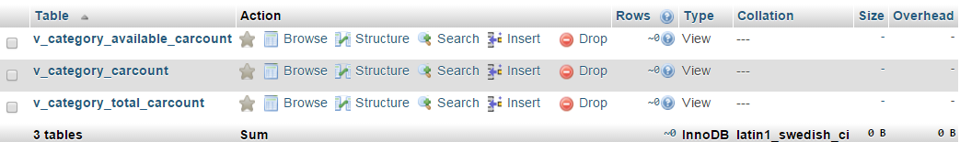
Views

Slide 14
Indexes Customer Table
INDEX index_customer_email (email_id) – Non Clustered
INDEX index_customer_phone (phone_number)– Non Clustered
INDEX index_customer_name (last_name, first_name)-– Non Clustered

Slide 15
Indexes Car Category Table
INDEX index_carcategory_id (category_id)-- Clustered
INDEX index_carcategory_name (category_name) )– Non Clustered
INDEX index_carcategory_price (renting_price) )– Non Clustered

Slide 16
Indexes Car Table
INDEX index_car_VIN (VIN)– Non Clustered
INDEX index_car_category (category_id)– Non Clustered
INDEX index_car_licenseplate (license_plate) – Non Clustered

Slide 17
Indexes Driver Table
INDEX index_driver_reservation (reservation_id, license_id) )– Non Clustered
INDEX index_driver_name (last_name, first_name) – Non Clustered

Slide 18
DEMO

Slide 19
Challenges we faced
Identifying entities and the relationships.
Identifying the cardinalities.
Normalizing the tables.
Group Meeting Scheduling
Task Allocation and Management

Slide 20
Questions?

